Slide 1
Example Slides
Published 15 Jan 24
South East PAT
england.datasouth@nhs.net

Slide 2
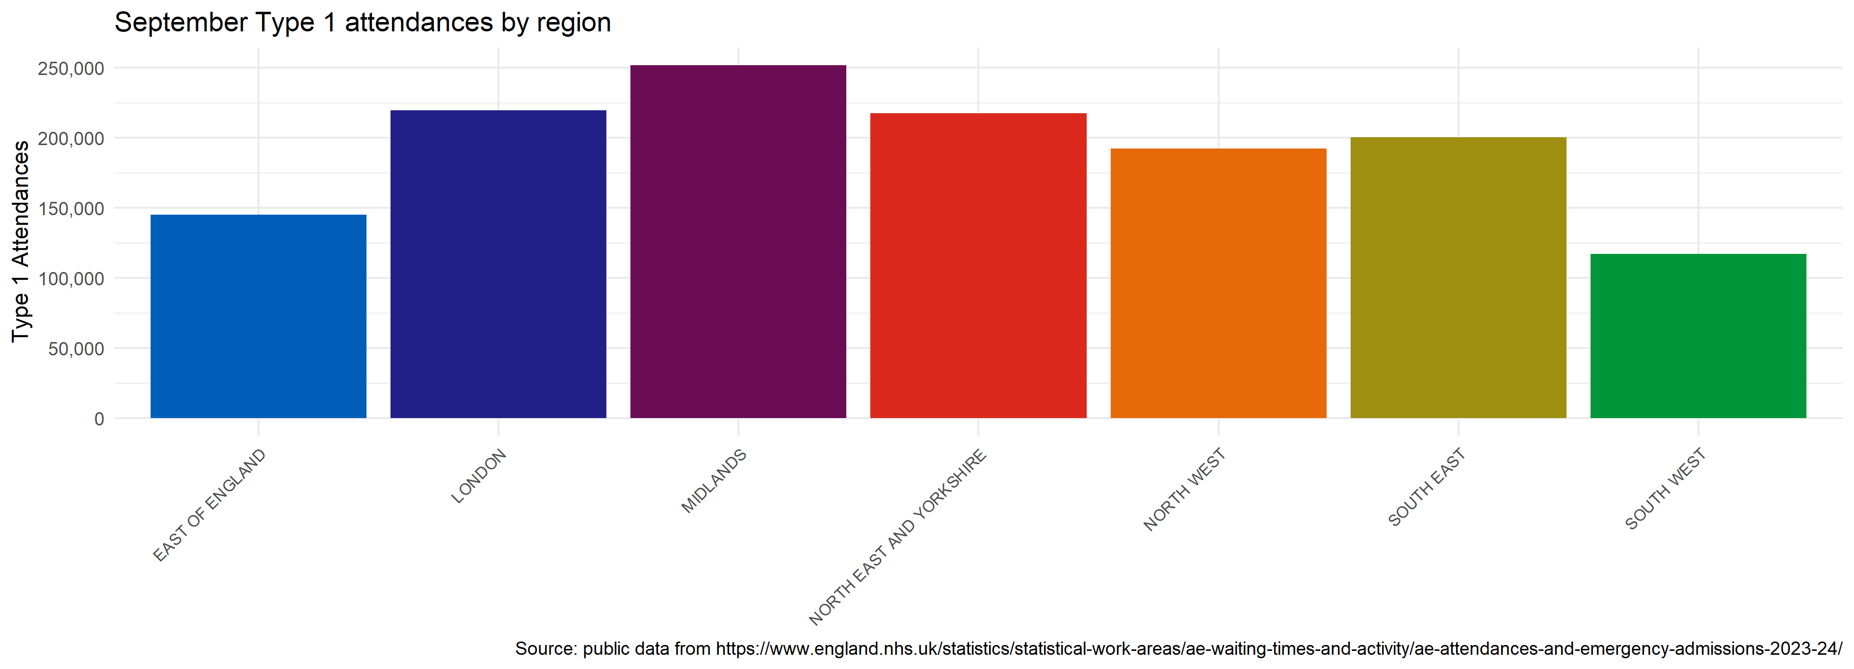
An example plot
Code run on 15 Jan 24
An example subtitle
Some example text Could be replaced with automated commentary
Source: published monthly sitrep data up to September 2023

Slide 3
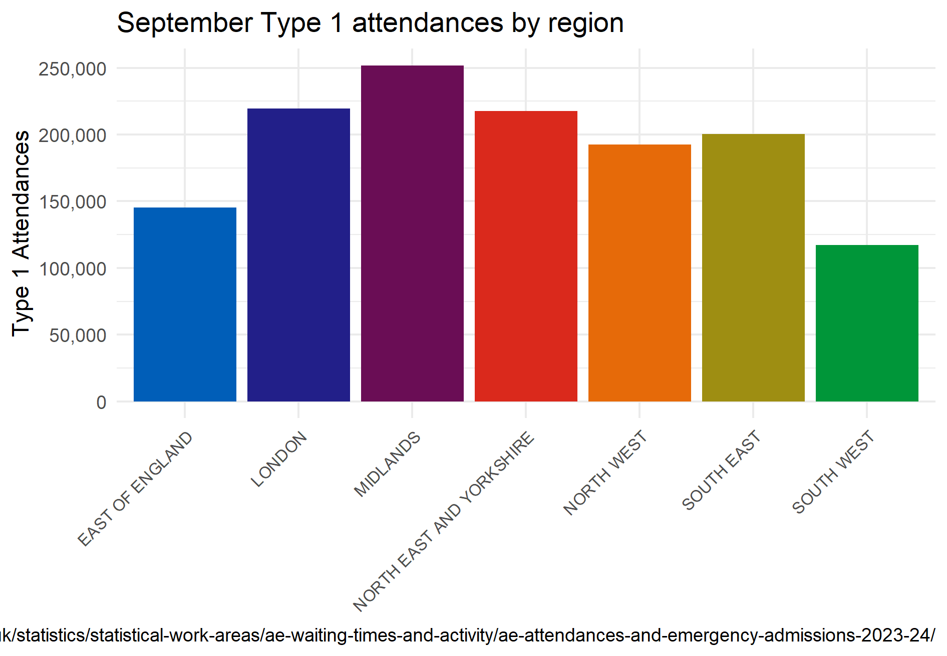
Different layout
Putting things in different places

